Slide 1
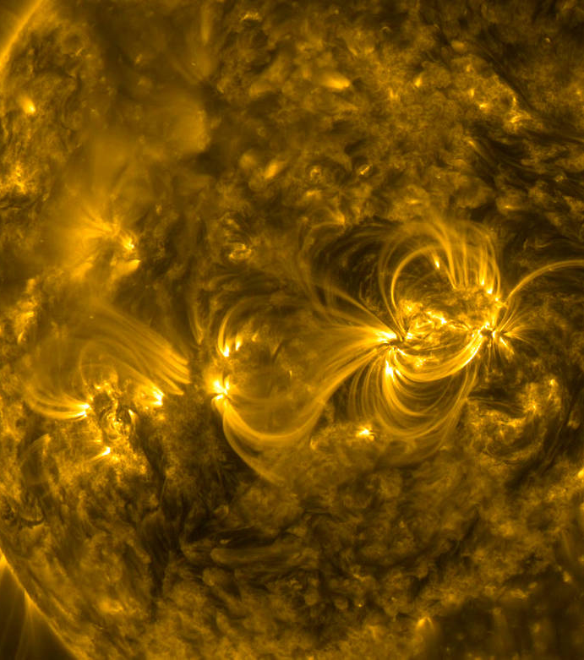
MACHINE LEARNING AND DEEP LEARNING IN SOLAR PHYSICS
FINAL DEGREE PROJECT
YAZMINA ZURITA MARTEL
supervised by:
DR. ANDRÉS ASENSIO RAMOS

Slide 2
Preamble
Introduction
Objectives and motivation
Methodology
Results
Conclusions

Slide 3
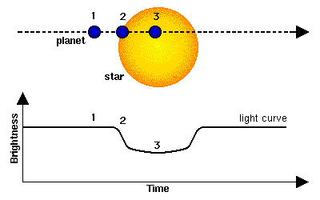
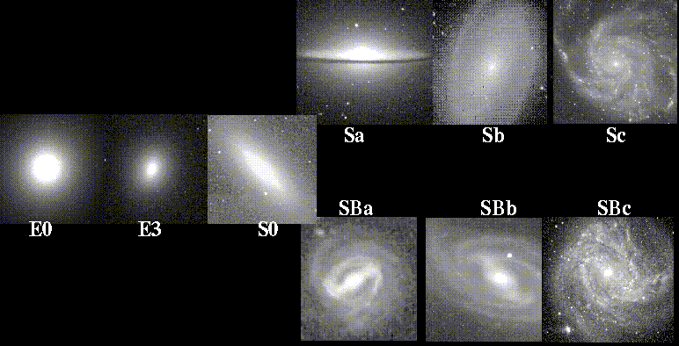
Machine Learning and Astrophysics
Other applications? → Inversion of Stokes Profiles

Slide 4
Preamble
Introduction
Objectives and motivation
Methodology
Results
Conclusions

Slide 5
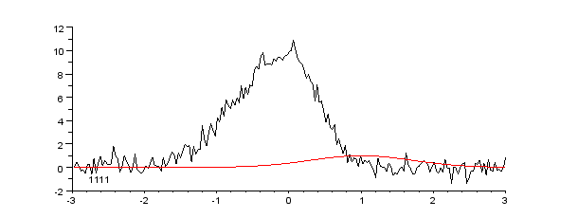
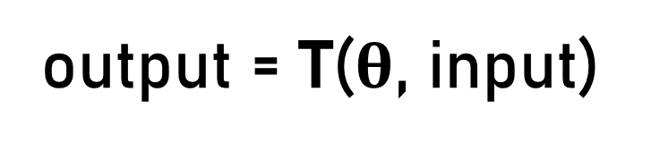
Machine Learning and Deep Learning
output = T($θ$, input)

Slide 6
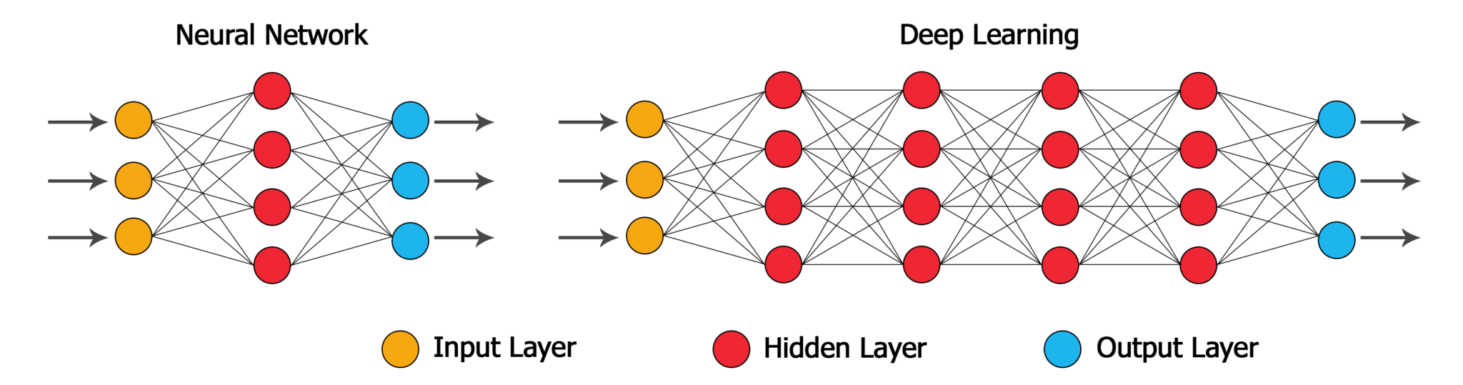
Machine Learning and Deep Learning
Deep Neural Network
Shallow neural Network

Slide 7
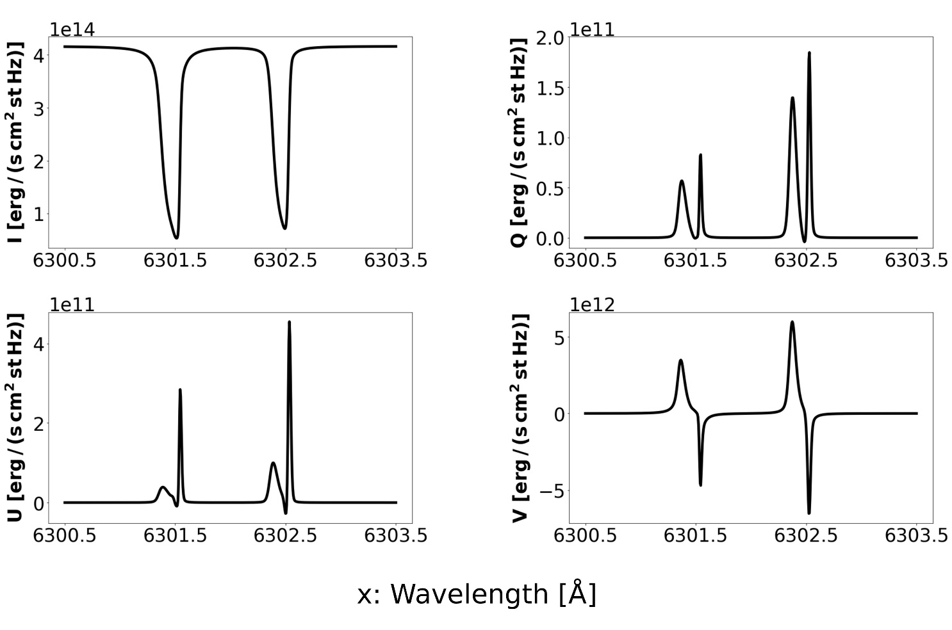
Stokes Profiles

Slide 8
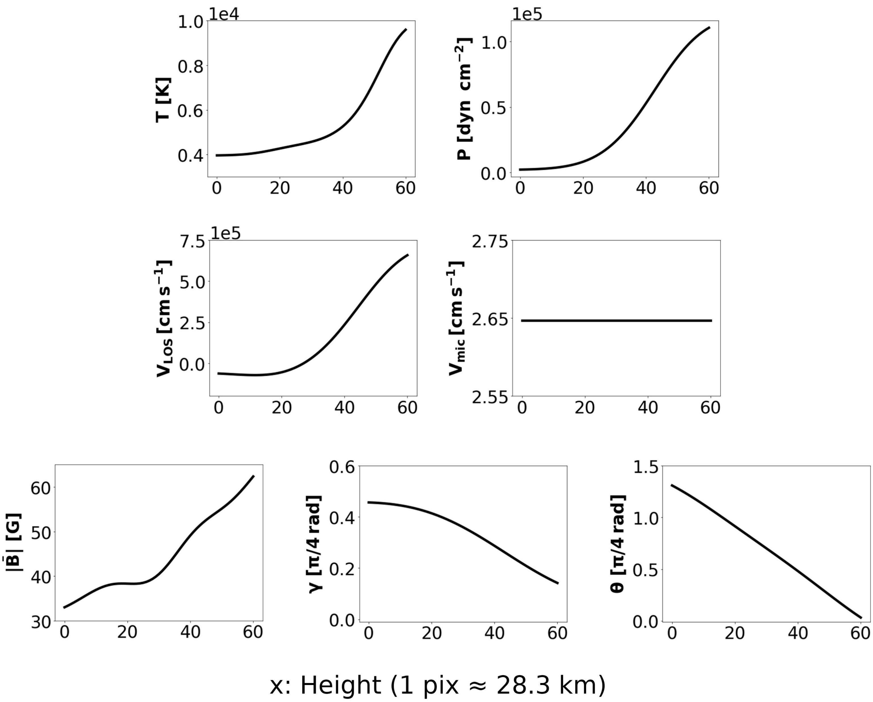

Synthesis of Stokes Profiles
RTE

Slide 9
Inversion of Stokes Profiles

Slide 10
Preamble
Introduction
Objectives and motivation
Methodology
Results
Conclusions

Slide 11
Objectives and motivation

Slide 12
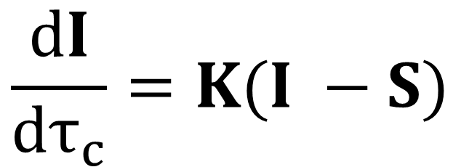
Objectives and motivation
$$\frac{dI}{dτ_{c}}=K(I −S)$$
NLTE
Drawback: High computation time

Slide 13
Objectives and motivation
Alternative: ANN synthesis

Slide 14
Preamble
Introduction
Objectives and motivation
Methodology
Results
Conclusions

Slide 15
Methodology

Slide 16
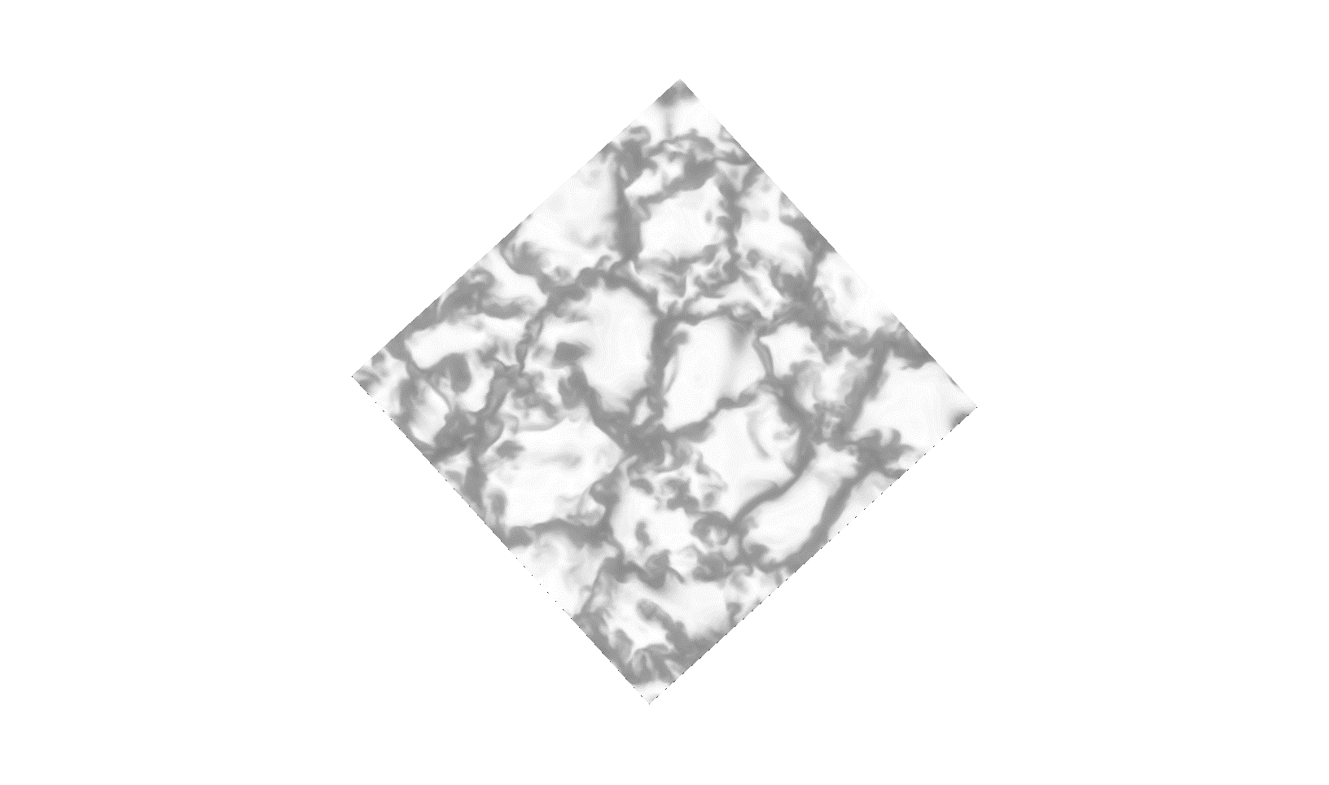
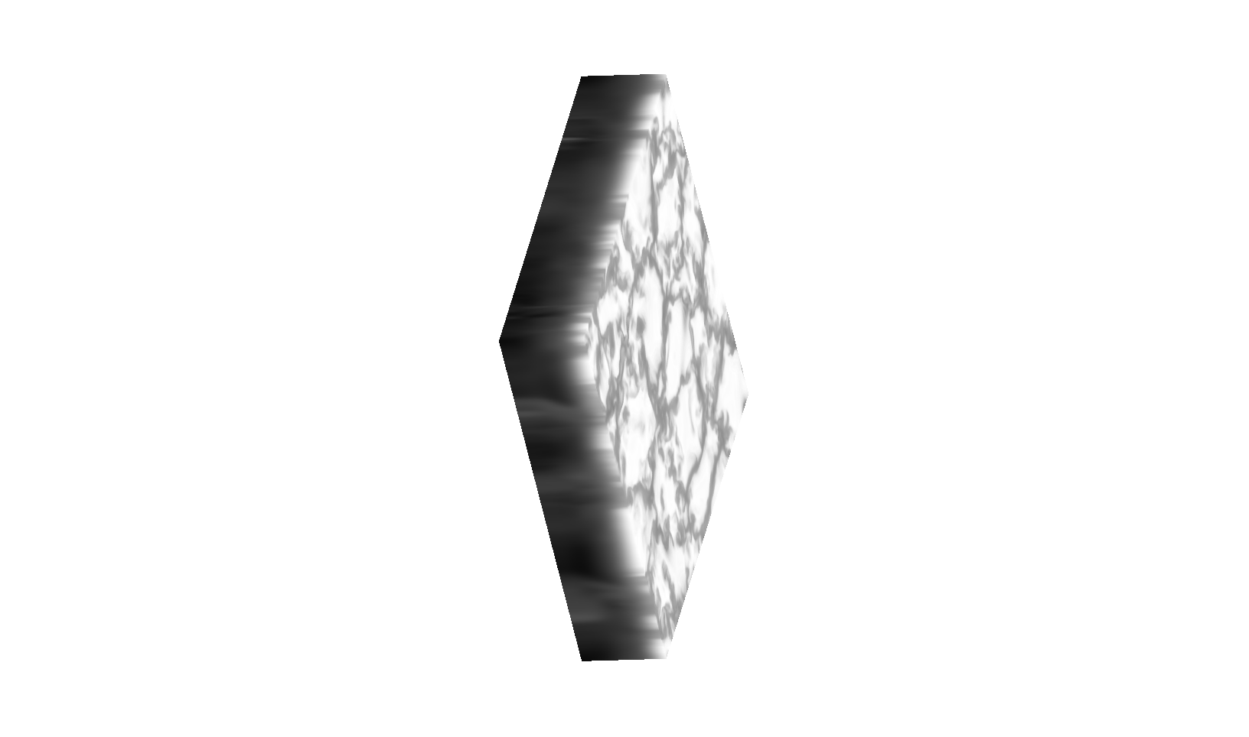
Dataset
288 pixels
61 pixels
288 pixels
x 7

Slide 17

Dataset
288 x 288 samples

Slide 18
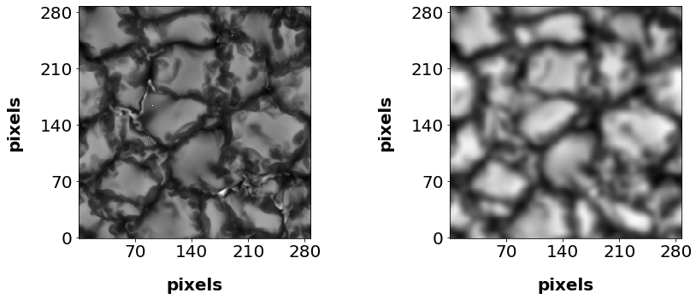
Data degradation
=
*
PSF

Slide 19
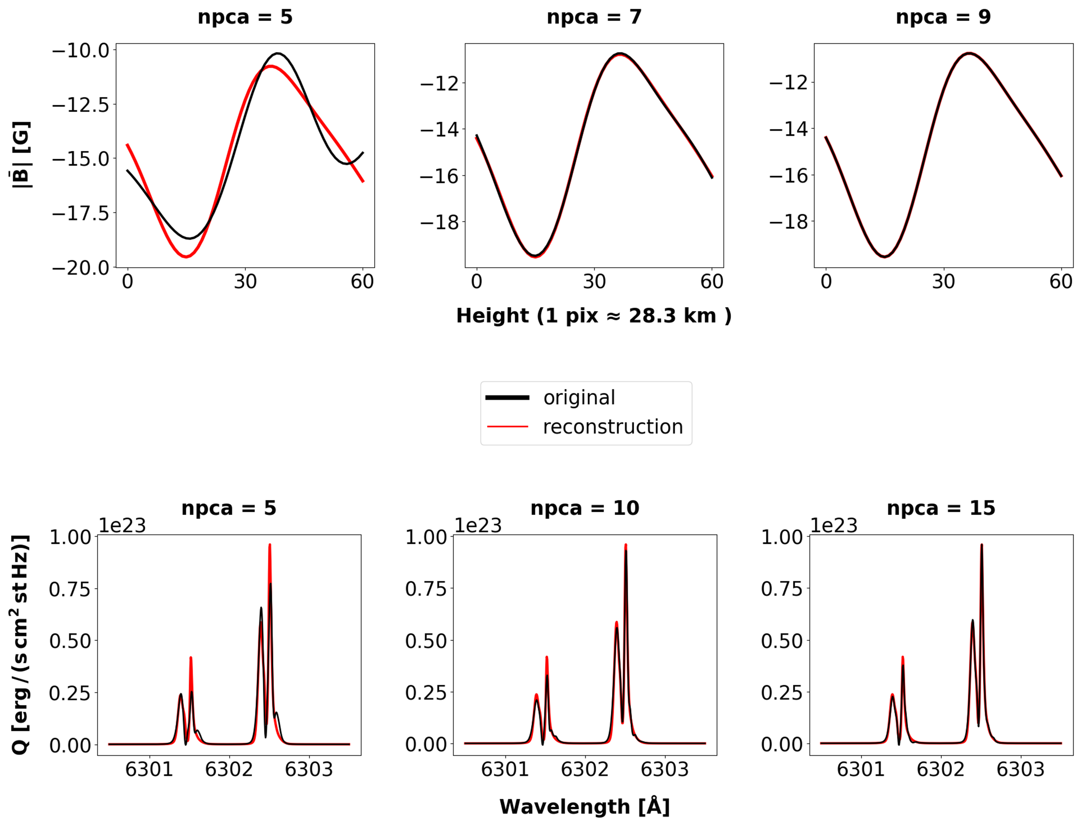
Principal Component Analysis

Slide 20
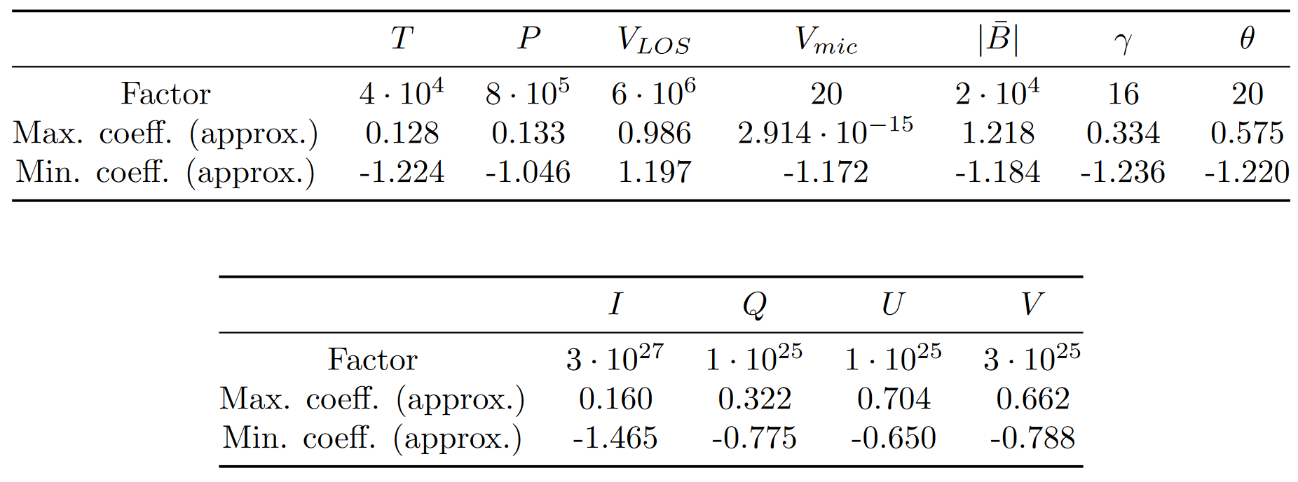
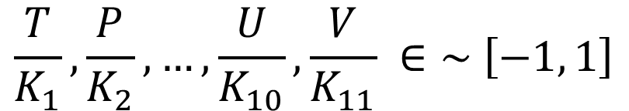
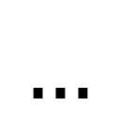
Rescaling
$$\frac{T}{K_{1}}, \frac{P}{K_{2}},…,\frac{U}{K_{10}},\frac{V}{K_{11}} ∈\sim \left[−1, 1\right]$$
$$…$$

Slide 21
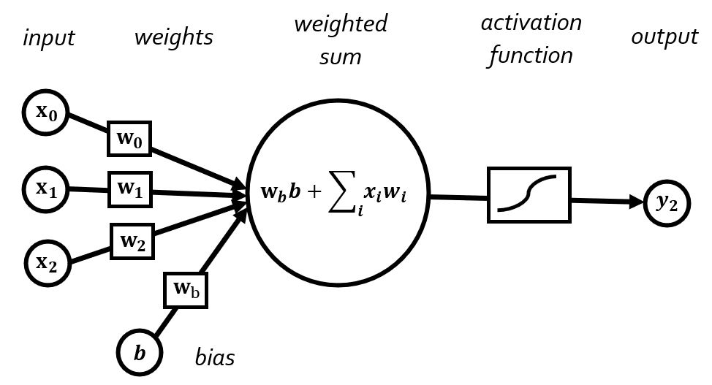
Architecture
Fully connected, feed forward

Slide 22
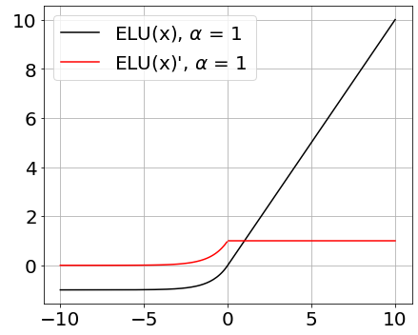
Architecture

Slide 23
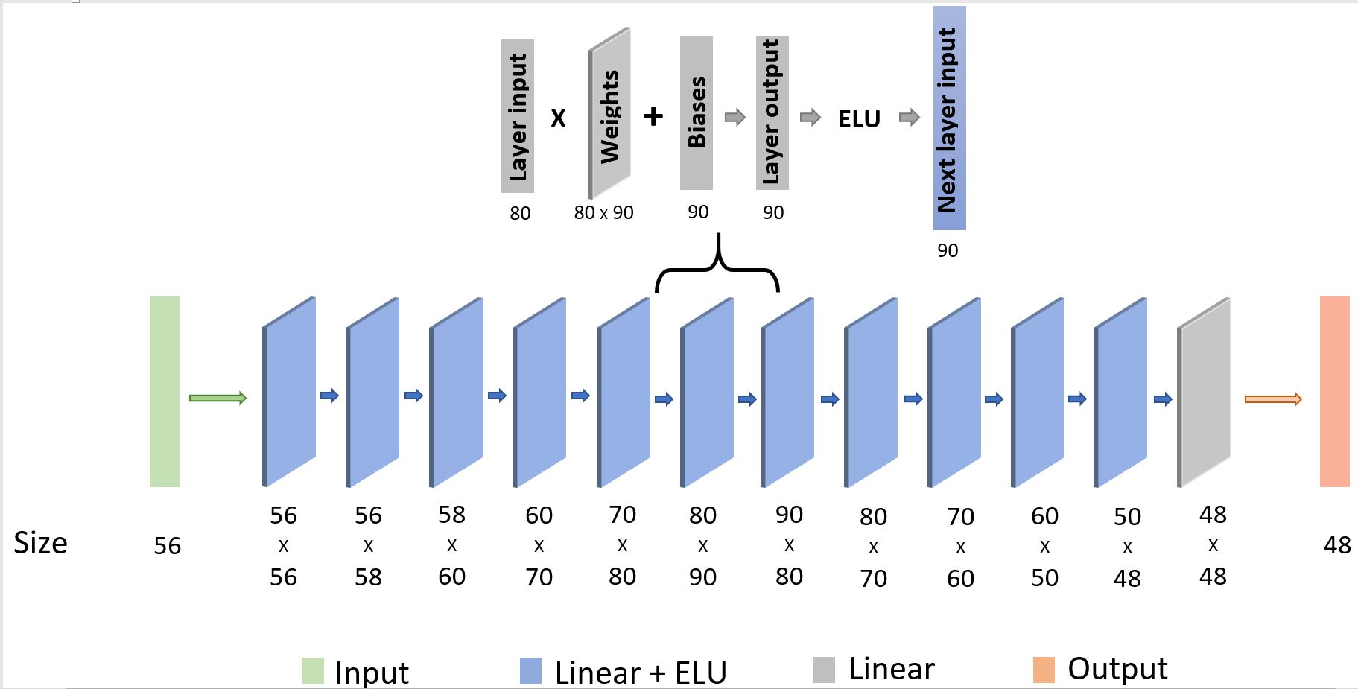
Architecture

Slide 24
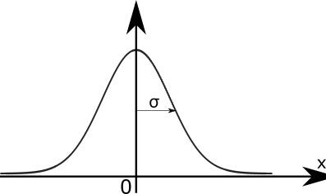
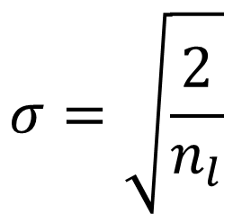
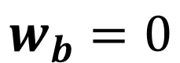
Architecture
Kaiming initialization
$$σ=\sqrt{\frac{2}{n_{l}}}$$
$$w_{b}=0$$

Slide 25

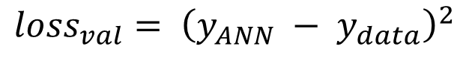
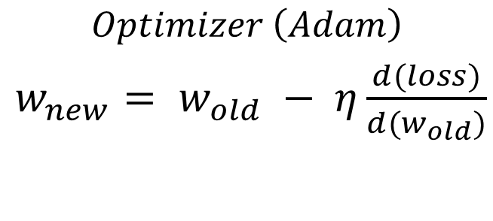
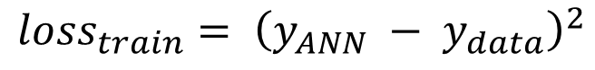
Training process
Training set (80%)
Validation set (20%)
$${loss}_{train}= {\left(y_{ANN} − y_{data}\right)}^{2}$$
$${loss}_{val}= {\left(y_{ANN} − y_{data}\right)}^{2}$$
$$Optimizer \left(Adam\right)$$
$w_{new}= w_{old} − η\frac{d(loss)}{d(w_{old})}$
1189 epochs

Slide 26
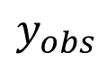
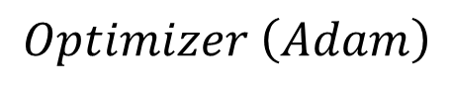
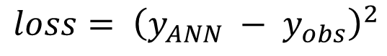
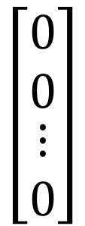
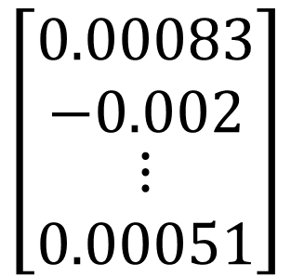
Inversion
$$\left[\begin{matrix}0.00083 \\ −0.002 \\ \begin{matrix}⋮ \\ 0.00051\end{matrix}\end{matrix}\right]$$
$$\left[\begin{matrix}0 \\ 0 \\ \begin{matrix}⋮ \\ 0\end{matrix}\end{matrix}\right]$$
$$y_{obs}$$
$$loss= {\left(y_{ANN} − y_{obs}\right)}^{2}$$
$$Optimizer \left(Adam\right)$$
158839 iterations

Slide 27
Preamble
Introduction
Objectives and motivation
Methodology
Results
Conclusions

Slide 28
Results

Slide 29
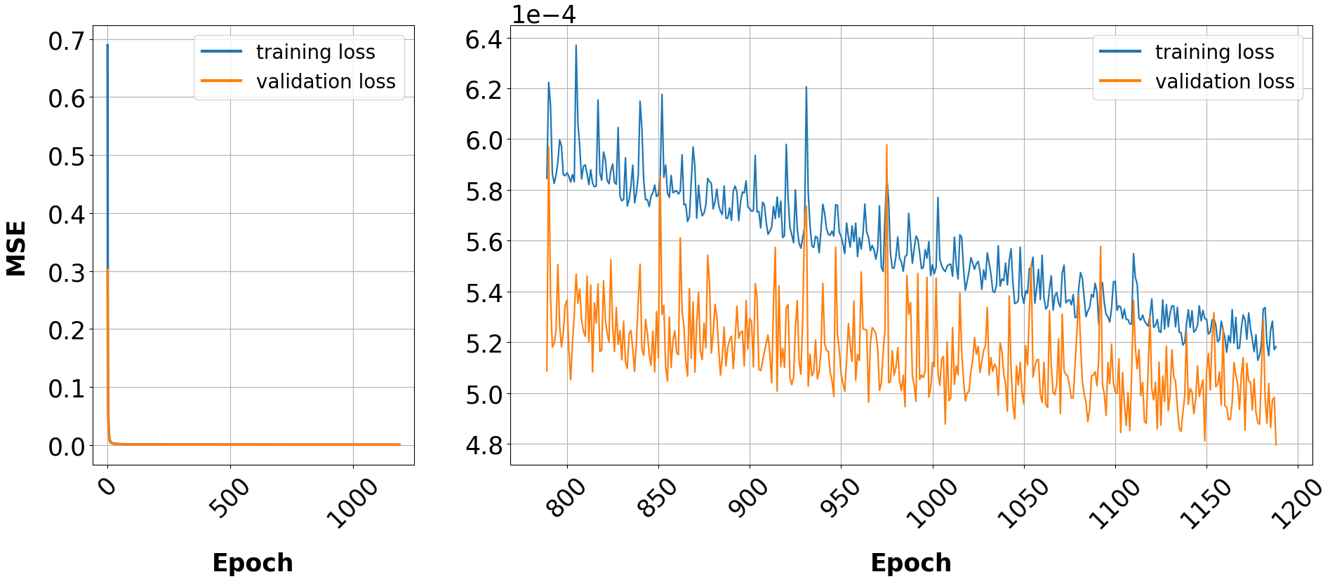
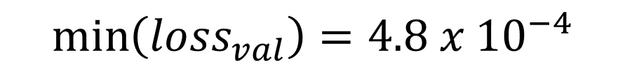
ANN training
$$\min\left({loss}_{val}\right)=4.8 x {10}^{−4}$$

Slide 30
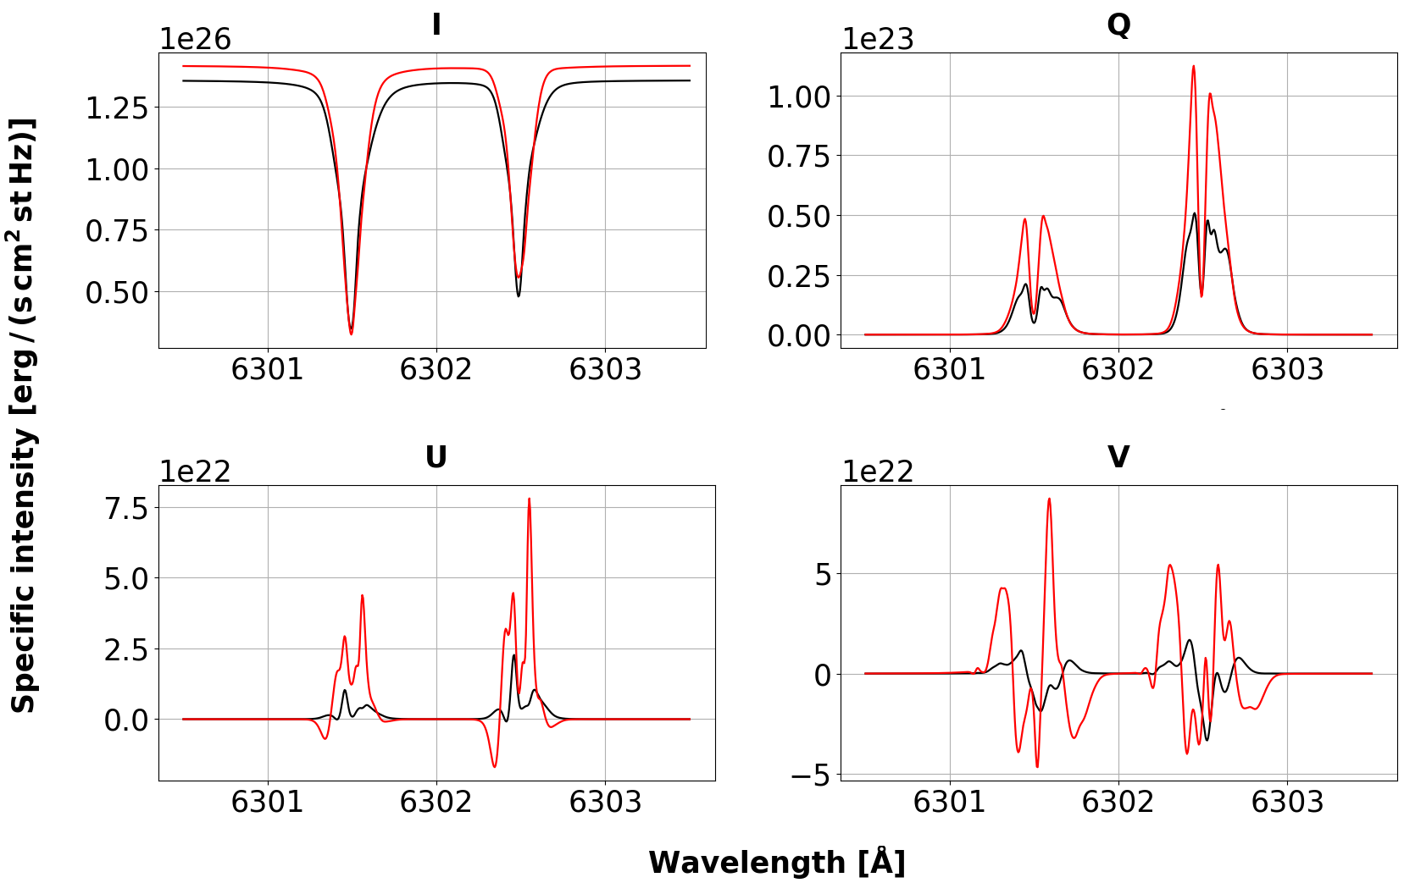
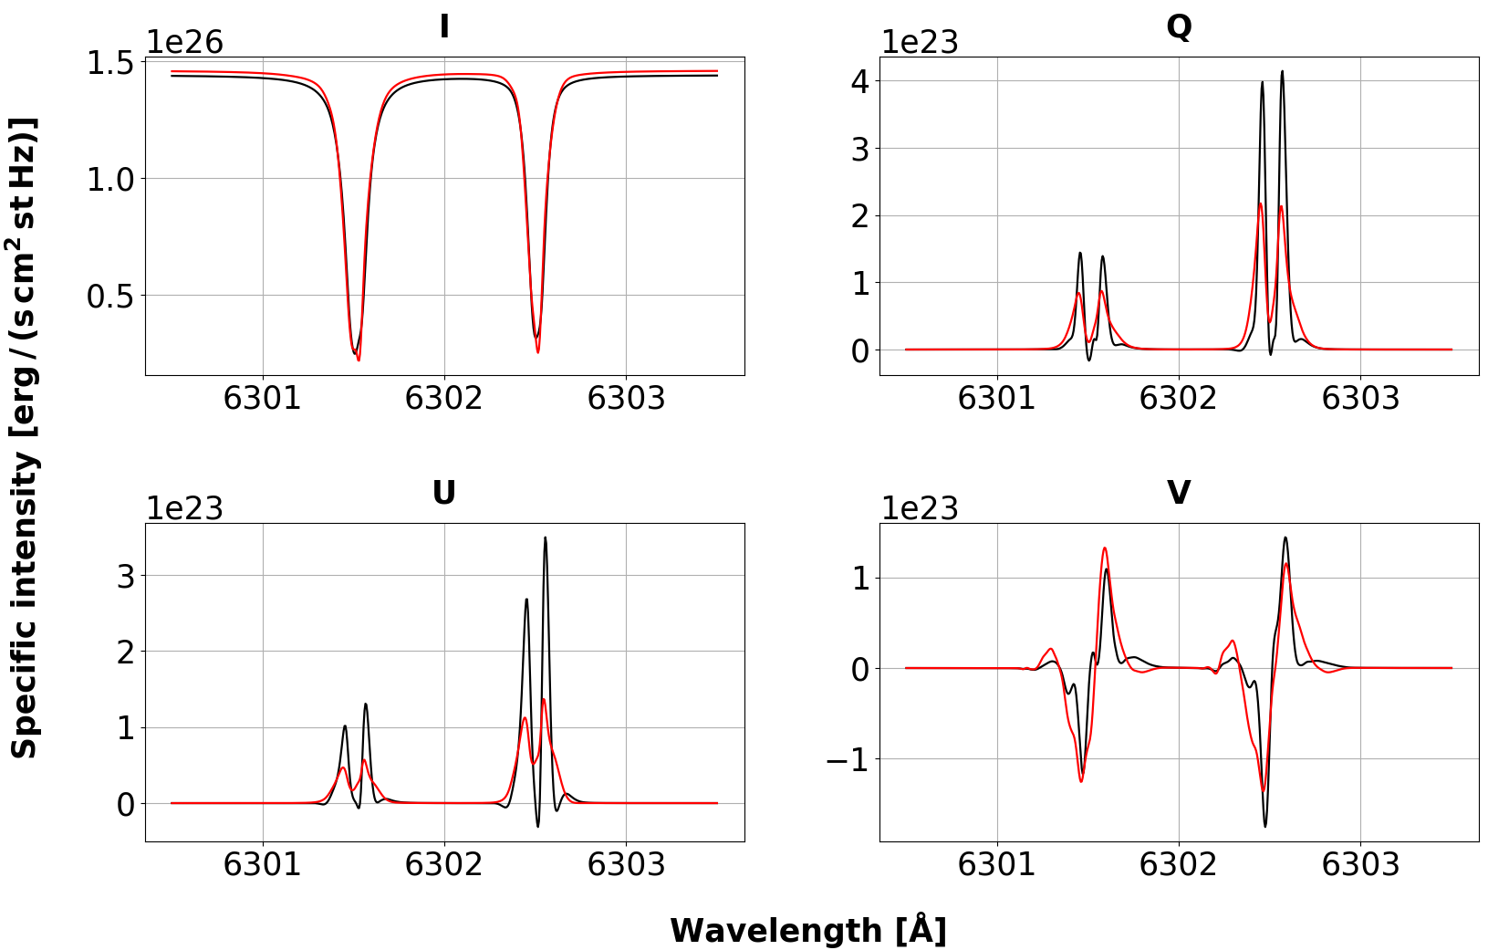
ANN training

Slide 31
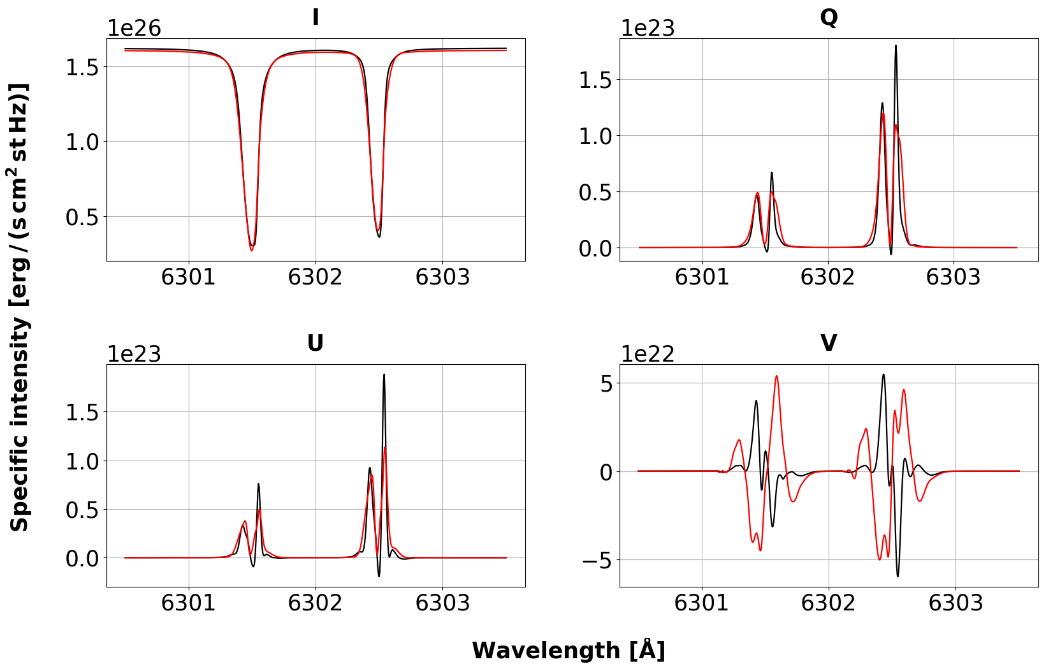
ANN training

Slide 32
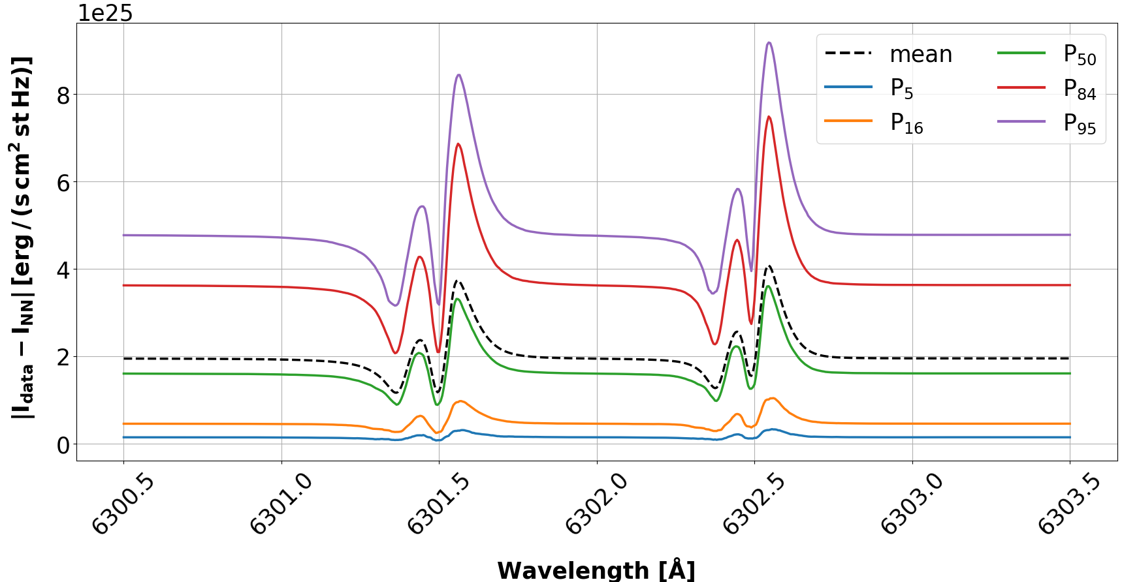
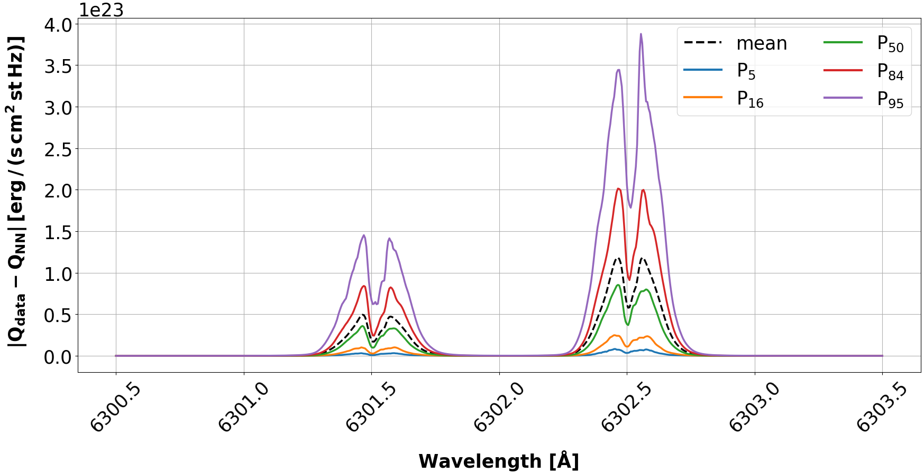
ANN training
$$I \sim {10}^{25}−{10}^{26} Q, U,V \sim {10}^{22}−{10}^{23}$$

Slide 33
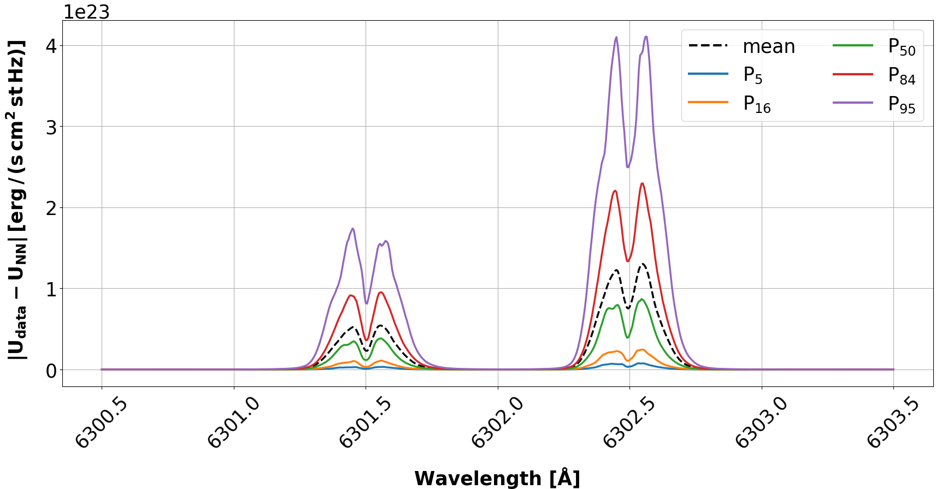
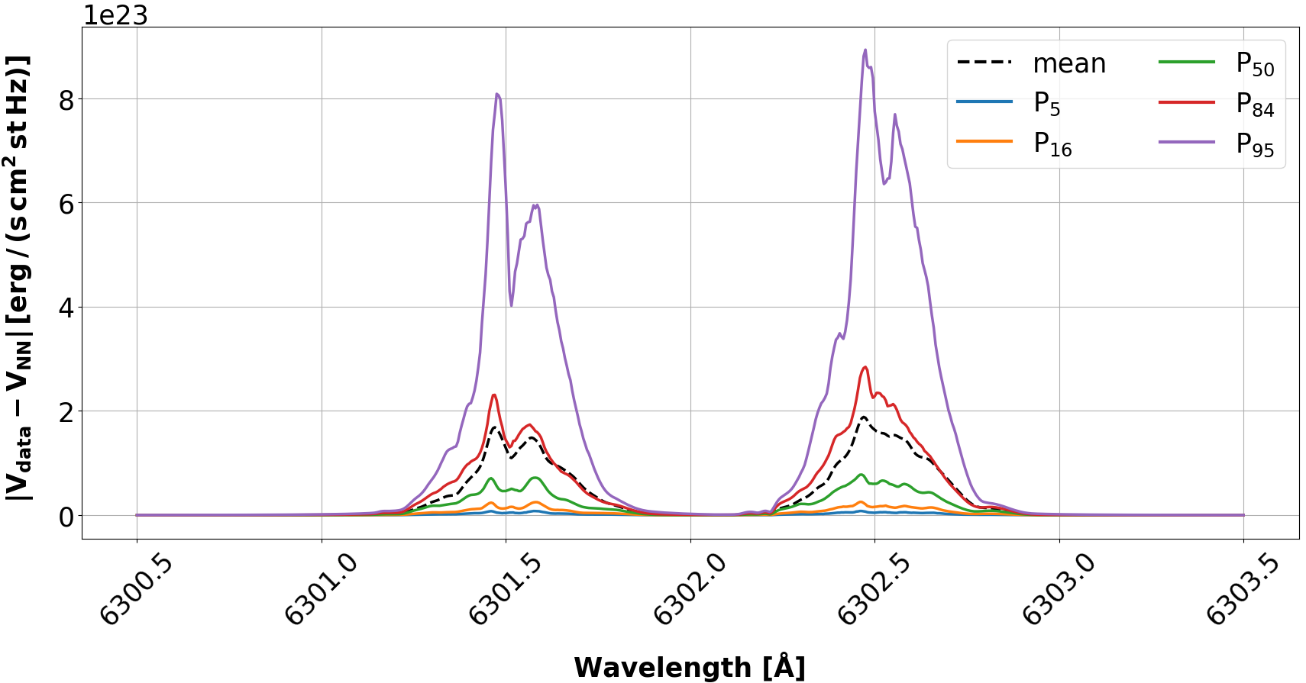
ANN training
$$I \sim {10}^{25}−{10}^{26} Q, U,V \sim {10}^{22}−{10}^{23}$$

Slide 34
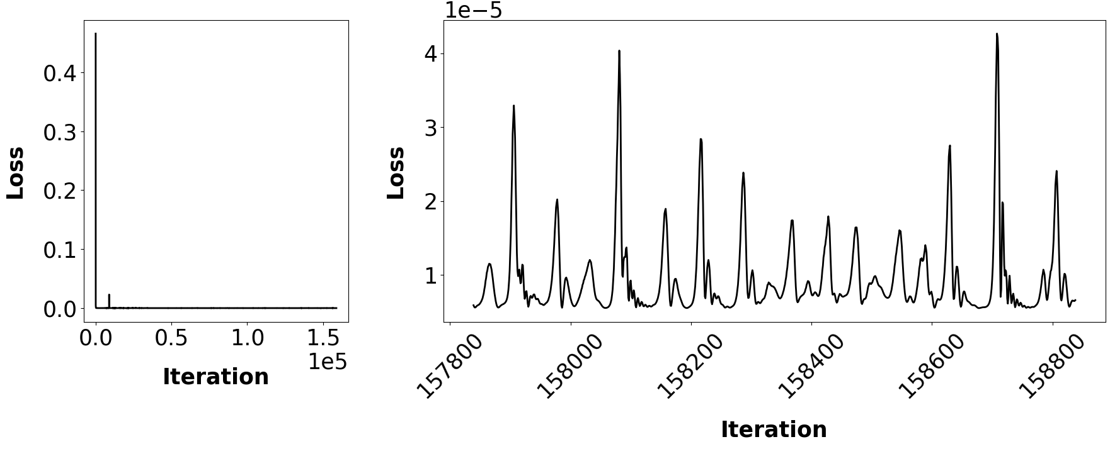
Inversion

Slide 35
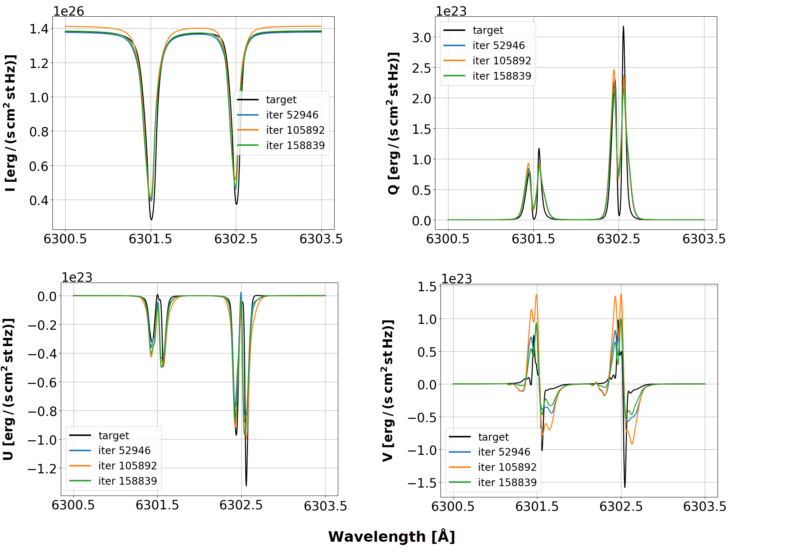
Inversion

Slide 36
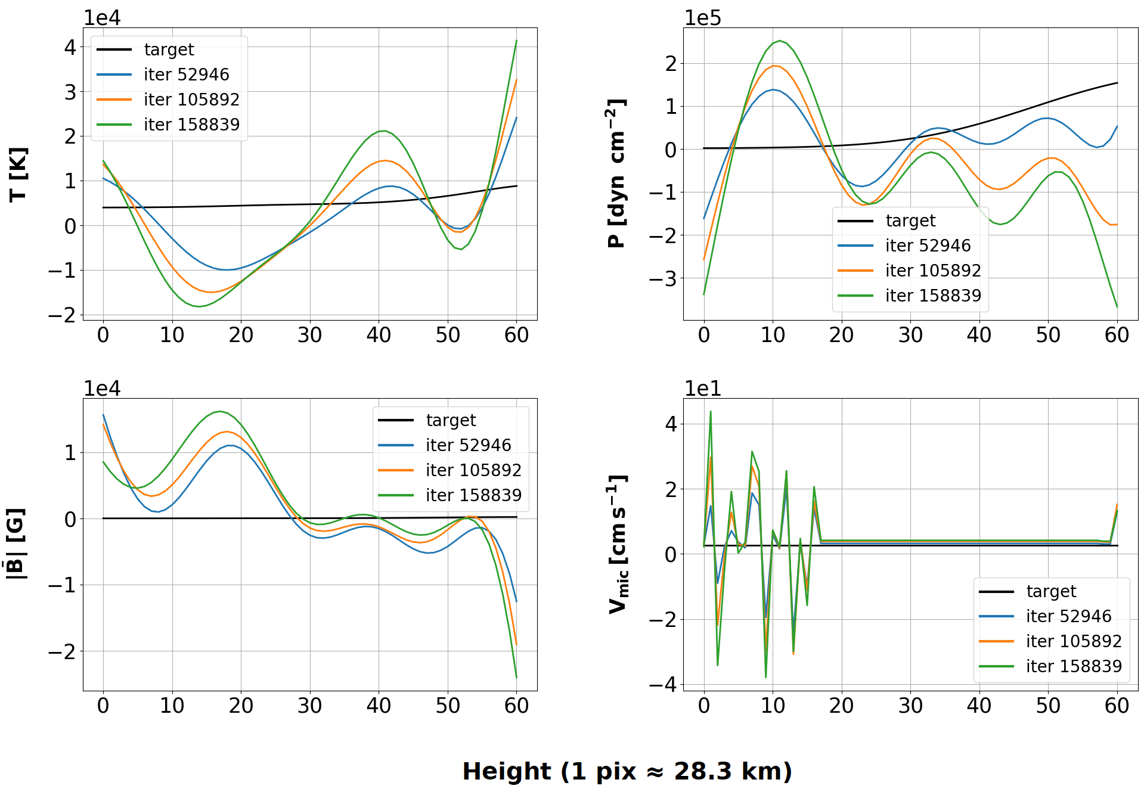
Inversion

Slide 37
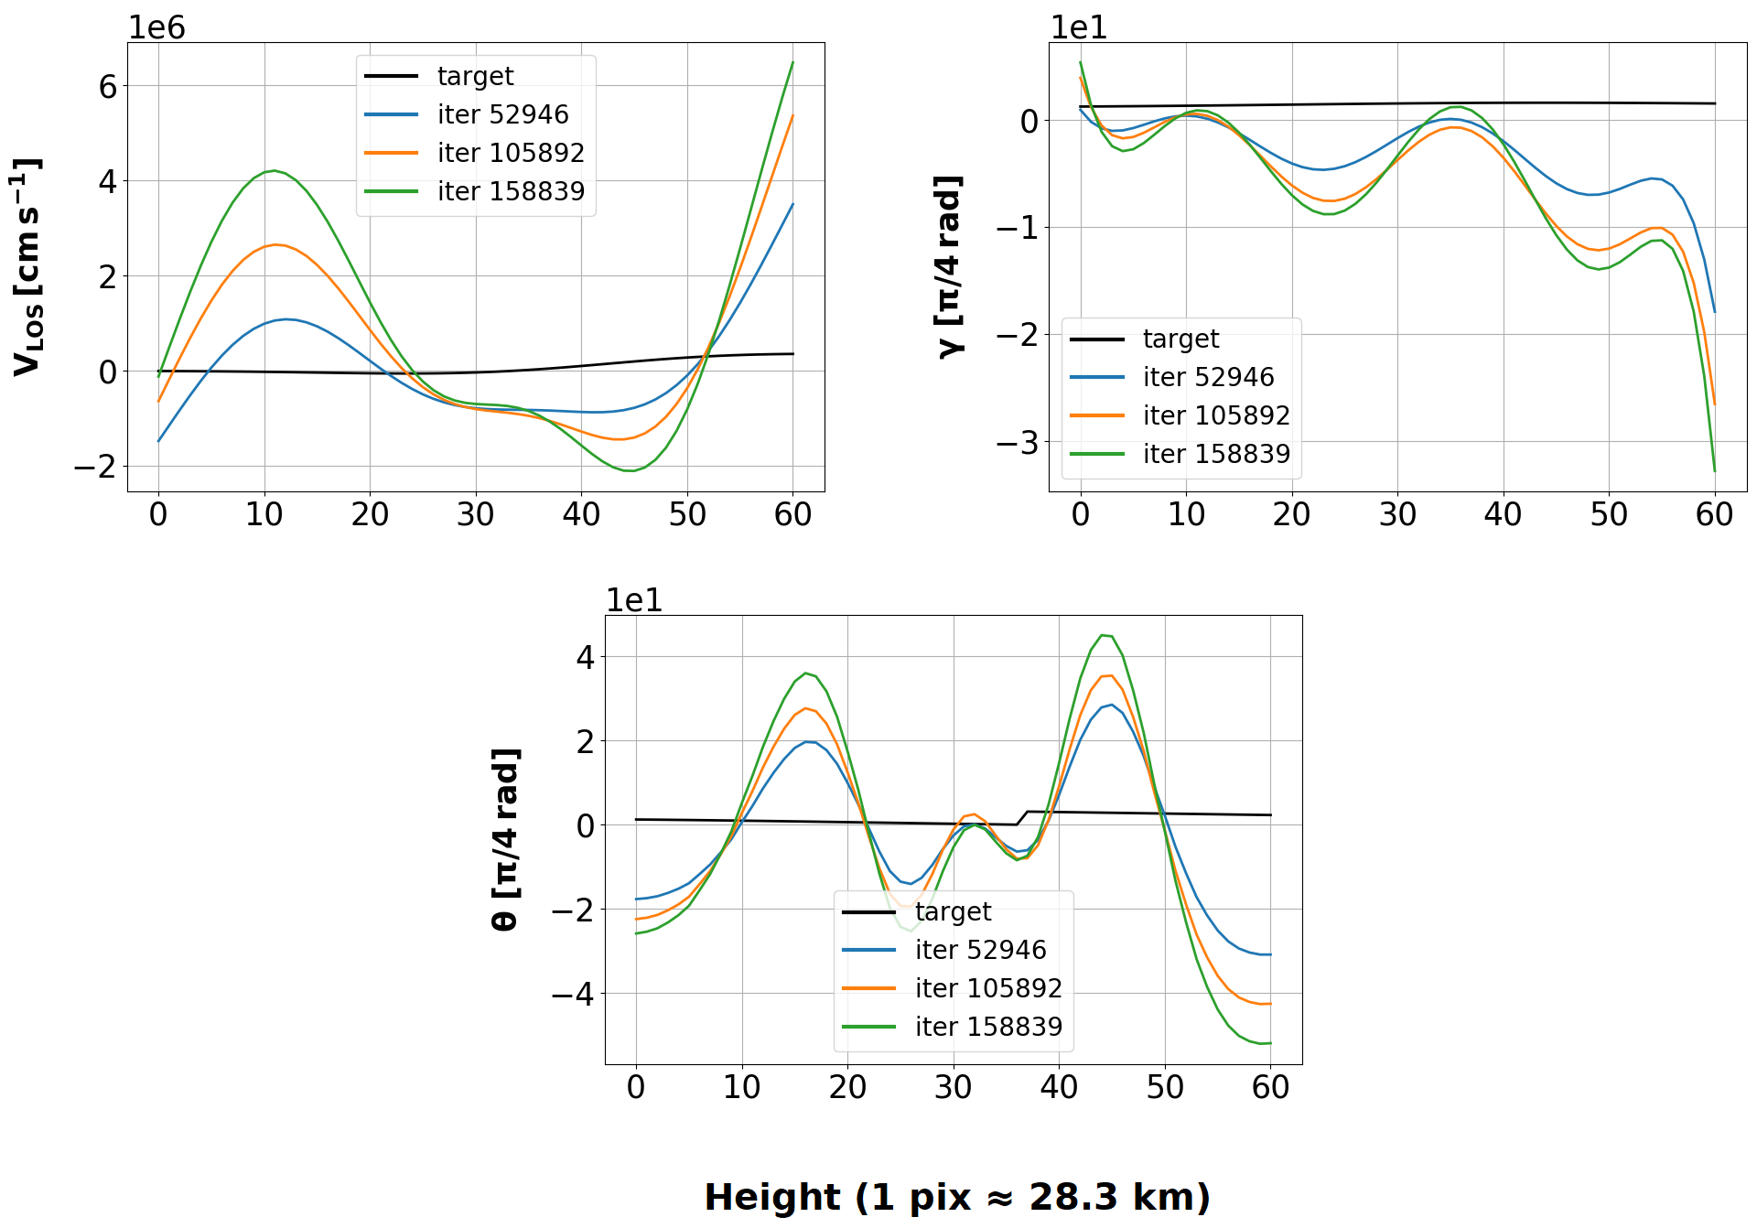
Inversion

Slide 38
Conclusions
Poorly adjusted profiles
Ineffective to carry out inversions
Room to improve: customizable, future developments....

Slide 39
THANK YOU

